Slide 1



Learning Distributed Representations of Symbolic Structure Using Binding and Unbinding Operations
Shuai Tang, Paul Smolensky, Virginia R. de Sa

Slide 2

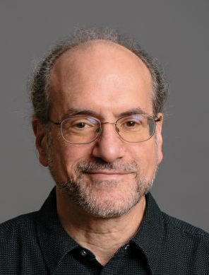

Shuai Tang
Cognitive Science
UC San Diego
Paul Smolensky
Cognitive Science
Johns Hopkins University
Microsoft Research AI
Virginia R. de Sa
Cognitive Science
UC San Diego

Slide 3
Outline
Motivations
Our Proposed Recurrent Unit
Experiments
Conclusions

Slide 4
Outline
Motivations
Our Proposed Recurrent Unit
Experiments
Conclusions

Slide 5
Distributed Representations
Symbolic Computing Systems
Inducing structure in data
Considerable power in statistical inference
Encoding word knowledge
Efficient usage of representation space
Symbol ---- Substructure
Representations maintain the structure of data explicitly
Each substructure can be retrieved with no loss
Inducing implicit structure from data
unique symbol ---- potential substructure
Notes:
Symbolic : potential for interpretabiliy

Slide 6
Distributed Representations
+
Symbolic Computing Systems
Inducing structure in data
Considerable power in statistical inference
Encoding word knowledge
Efficient usage of representation space
Symbol ---- Substructure
Representations maintain the structure of data explicitly
Each substructure can be retrieved with no loss
Inducing implicit structure from data
unique symbol ---- potential substructure
Learning Structured Distributed Representations
Notes:
Symbolic : potential for interpretabiliy

Slide 7
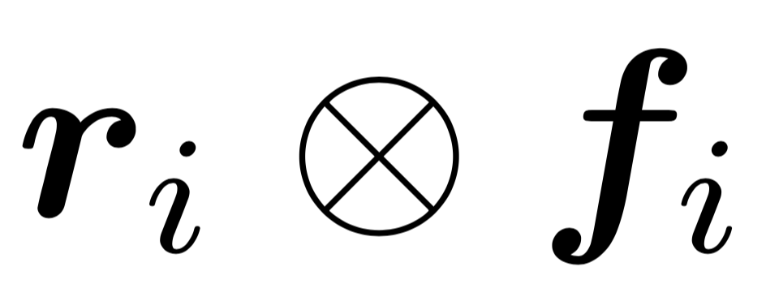
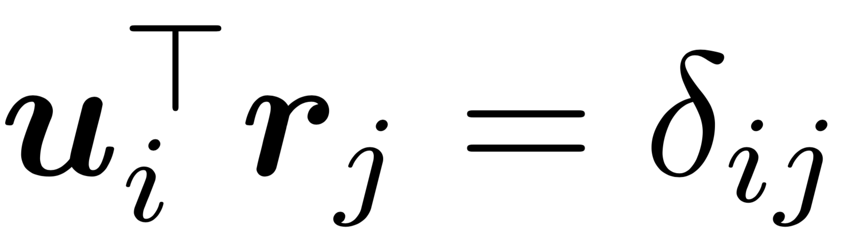
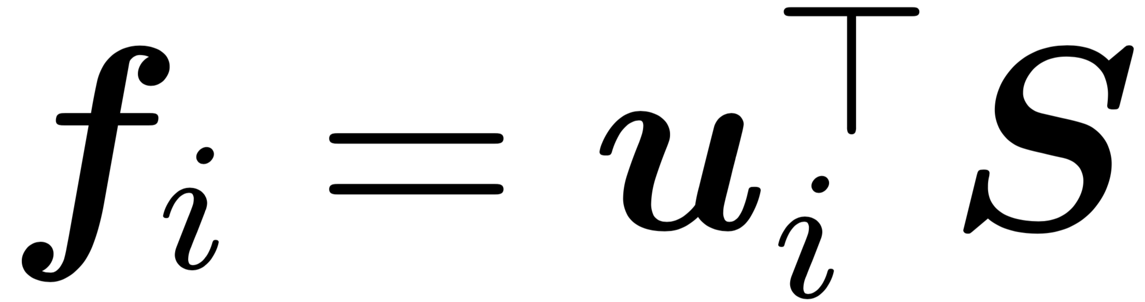
Tensor Product Representations (TPRs)
Binding Operation
Unbinding Operation

Slide 8
Tensor Product Representations (TPRs)
Symbols
Binding Operation
Unbinding Operation
Positions in a string
Part-of-speech tags
Context

Slide 9
Tensor Product Representations (TPRs)
Binding Operation
Unbinding Operation
Vector Representations

Slide 10
Tensor Product Representations (TPRs)
Binding Operation
Unbinding Operation
simplify
Vector Representations
simplify

Slide 11
Tensor Product Representations (TPRs)
Binding Operation
Unbinding Operation
Vector Representations
binding complex
binding complex

Slide 12
Tensor Product Representations (TPRs)
Binding Operation
Unbinding Operation
Vector Representations
learnt

Slide 13
Outline
Motivations
Our Proposed Recurrent Unit
Experiments
Conclusions

Slide 14
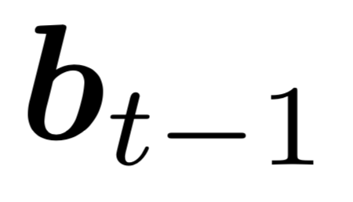
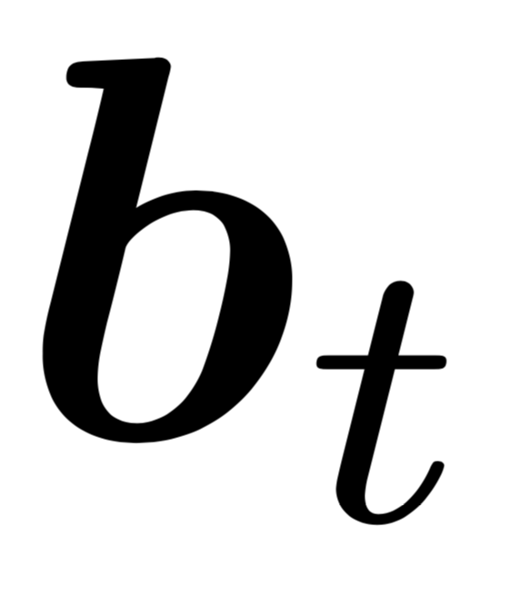
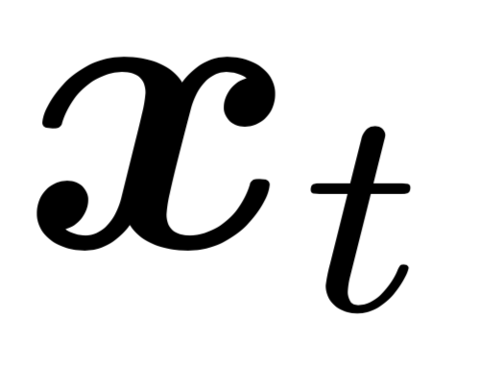
TPRU – Recurrent Unit
TPRU
Notes:
Have a slide for the information flow separately

Slide 15
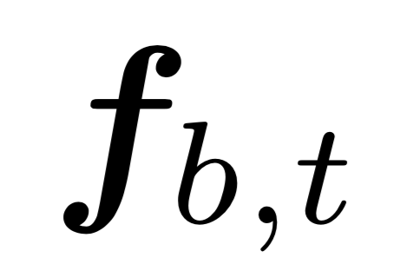
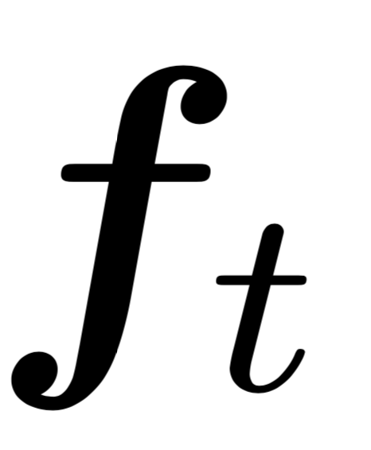
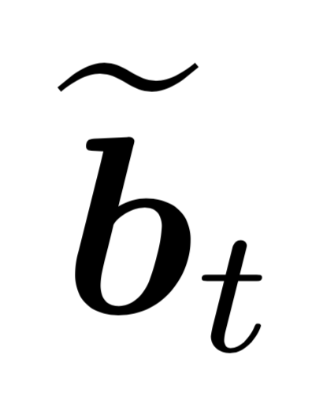
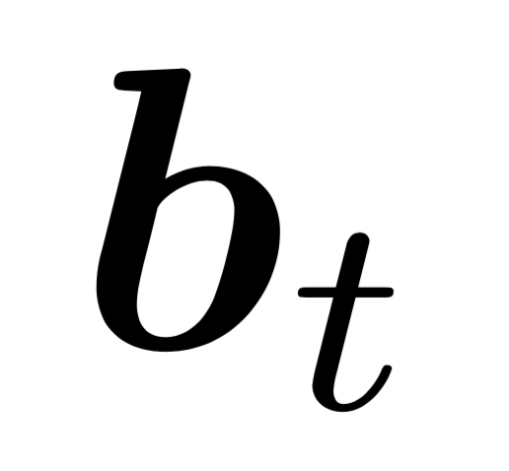
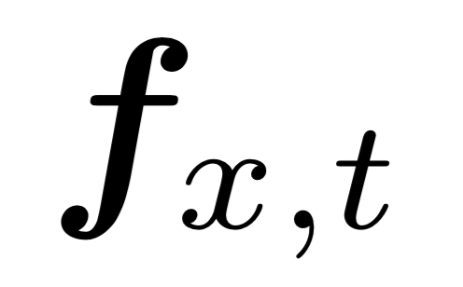


TPRU – Recurrent Unit
TPRU
Unbinding
Operation
Merging
Operation
Binding
Operation
Gating
Mechanism

Slide 16
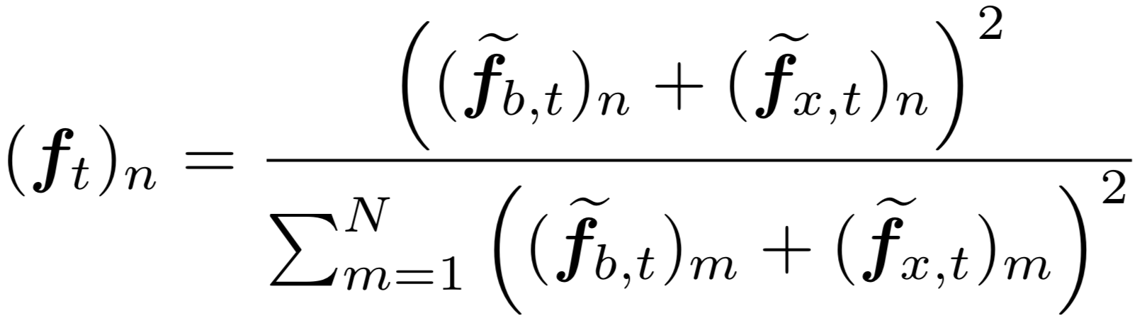
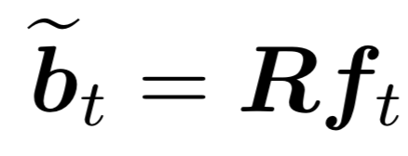
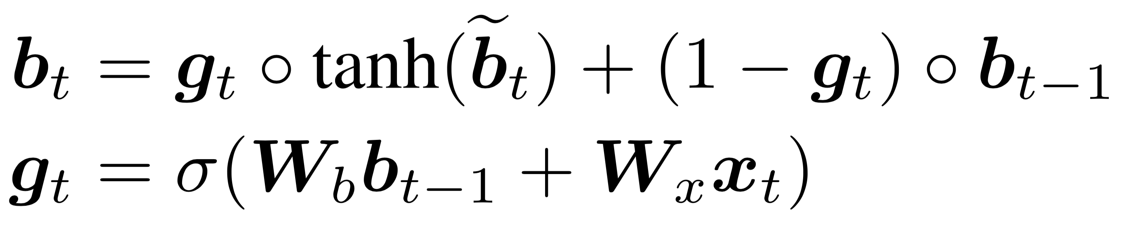
TPRU – Recurrent Unit
TPRU
Unbinding operation
Binding operation
Input Gate
Notes:
Write in words about the information flow instead of eqs.

Slide 17
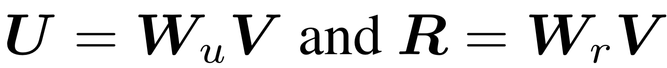
TPRU – Unbinding Vectors
Unbinding operation
Binding operation
Input Gate
Notes:
Have eqs in 8 here as well to people

Slide 18
TPRU – Binding Vectors
Unbinding operation
Binding operation
Input Gate

Slide 19
TPRU – Parameters
Unbinding operation
Binding operation
Input Gate

Slide 20
Outline
Motivations
Our Proposed Recurrent Unit
Experiments
Conclusions

Slide 21
Experiments
Tasks
Logical Entailment in Propositional Logic (Evans et al., 2018)
Multi-genre Natural Language Inference (Williams et al., 2018)
General Purpose Sentence Representations (Conneau & Kiela, 2018)
Plain & BiDAF architecture
BiDAF – Bi-Directional Attention Flow (Seo et al., 2017)
Notes:
Slightly explain plain and bidaf architectures
MLP as classifier with only one hidden layer

Slide 22
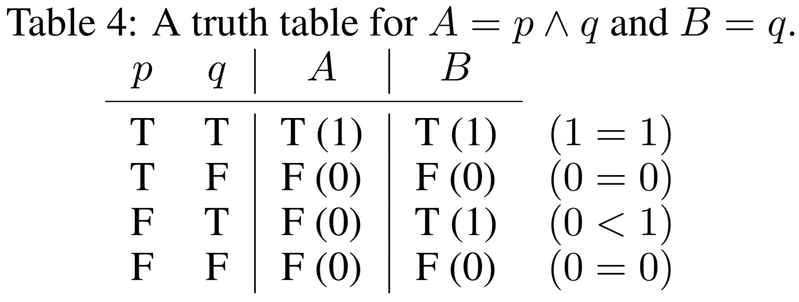
Logical Entailment in Propositional Logic
Training set
Validation set
Test set
easy, big, hard, massive, exam
Connectives matter

Slide 23
Logical Entailment in Propositional Logic
A: ((g>((x|s)|((q&i)&o)))&(s&((i|v)|x)))
Training set
Validation set
Test set
easy, big, hard, massive, exam
B: (~(((r|s)|q))>(~((q&(q|(s|r))))>(v|r)))
Connectives matter

Slide 24
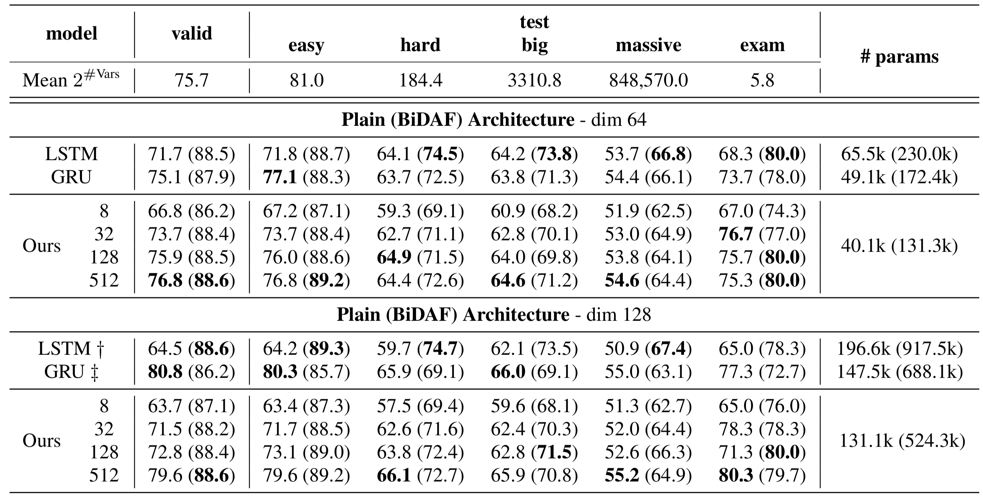
Logical Entailment in Propositional Logic
-
Notes:
Robustness
LSTM GRU

Slide 25
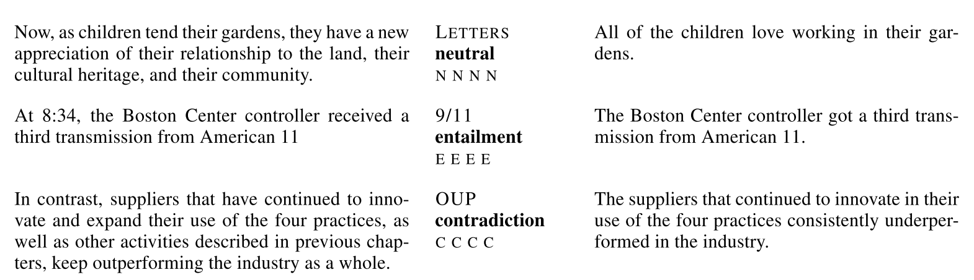
Multi-genre Natural Language Inference
5 genres available in training set
10 genres presented in dev and test set
Both structure and word meaning matter
Notes:
The task requires the model to infer the word meaning and also the structure of the sentences at the same time.

Slide 26
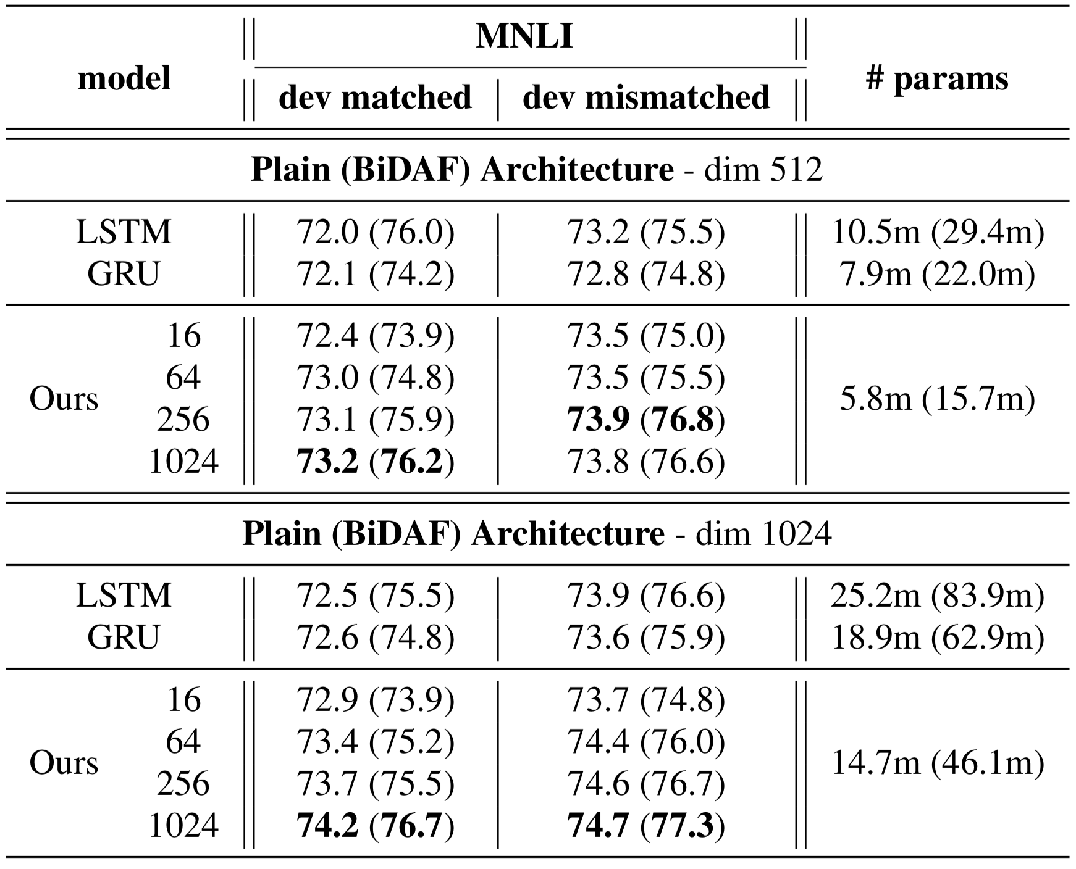
Multi-genre Natural Language Inference
Notes:
Mention that by adding more role vectors., the final results get better.

Slide 27
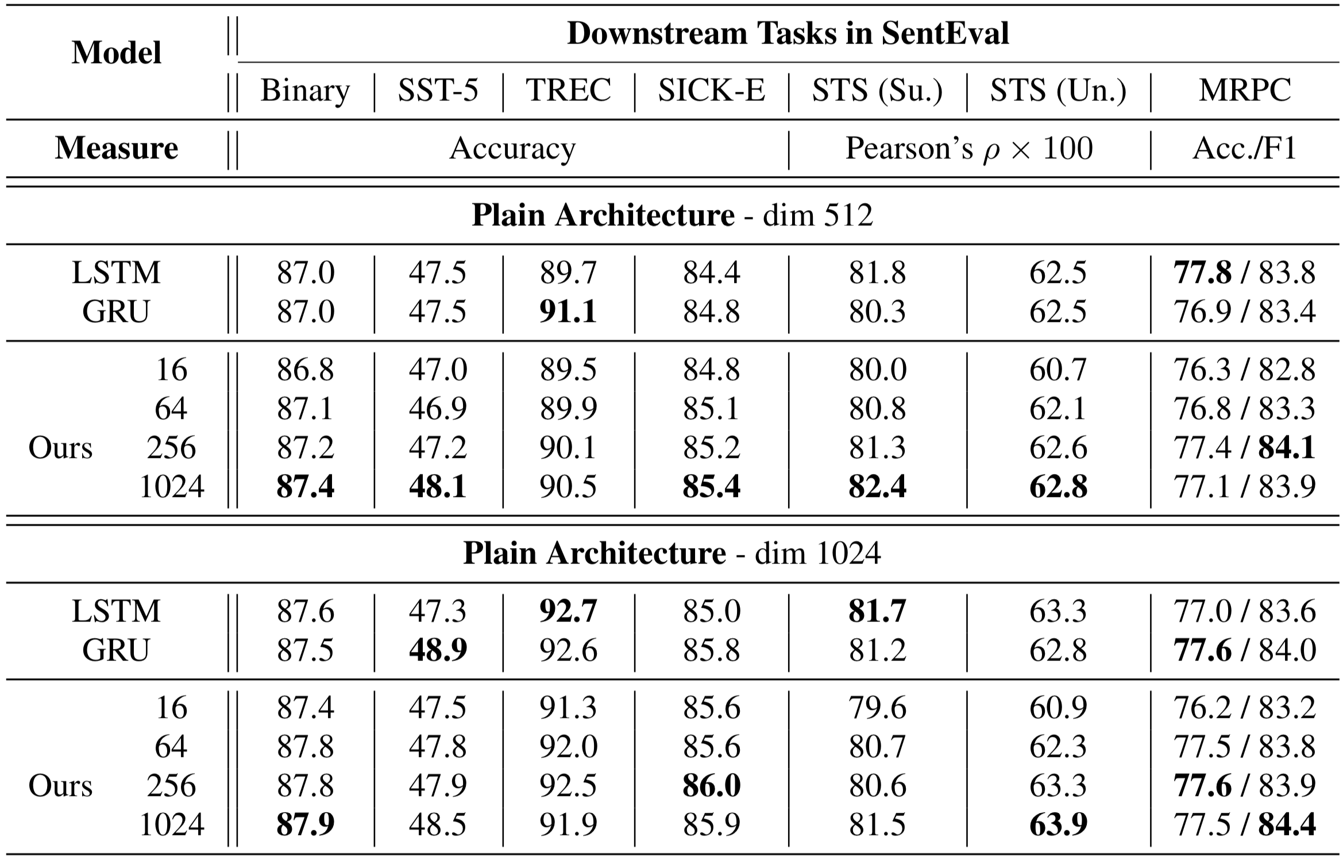
General Purpose Sentence Representations

Slide 28
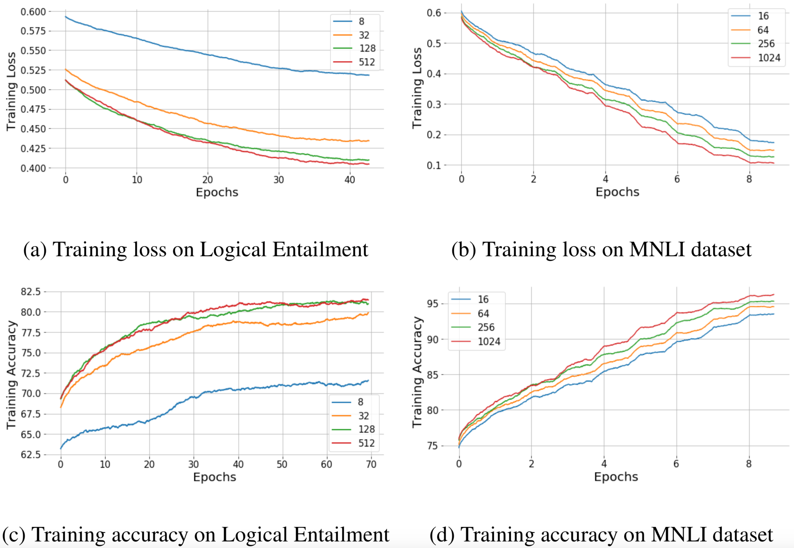
Incorporating more role vectors…
Faster convergence rate
Better performance

Slide 29
Outline
Motivations
Our Proposed Recurrent Unit
Experiments
Conclusions

Slide 30
Conclusions
A TPRU (Recurrent Unit) is proposed to leverage both
Distributed Representations
Neural-Symbolic Computing
Compared to LSTM and GRU
symbolic execution
reduced total number of parameters
comparable or better performance
Incorporating more role vectors leads to
faster convergence rate and better results

Slide 31


Thank you!
@Shuai93Tang
shuaitang93@ucsd.edu

